Slide 1
Drink and Dial
Data Driven approach for Clustering Nightlife Spots in New York
By - Yeetesh Verma

Slide 2
Introduction
On an unplanned or a casual night-out, people may want to or get pressured into drinking and when you drove by yourself it becomes very risky and is actually against the law to drive under influence of alcohol. In this situation Drink & Dial services come in handy which help by driving your car back to your home safely.
Main audience is a start-up who is planning to launch a new service for providing designated drivers to drive you back home in your own car.

Slide 3
Business Problem
Optimizing the operational clusters
Keep operations cost to minimum
With so many night-out points it becomes impractical to open Drive & Dial service for every Bar/Casino/other drinking places. So it becomes ideal to have a service point for a group of venues. We need to analyze the foursquare data of such night out joints and cluster the neighborhoods and have an optimum location for “Drive and Dial” hubs.

Slide 4
Data
The clustering would be done primarily on various Nightlife Spots in the “New York” city and then mapping them with data from FourSquare API about the Nightlife spots.
1. New York City Neighborhood Names
https://cocl.us/new_york_dataset
Geo-Location Coordinates
2. Foursquare Venues Data
List of all venues under category “Bars”

Slide 5
METHODOLOGY
Exploratory Data Analysis
In order to do the analysis and suggest the best location, following steps were followed:
A list of all neighborhoods in New York was extracted
Geo-locational coordinates were extracted
Using FourSquare API, for each neighborhood, data of all venues under category Bar was extracted.
Using K means clustering Venues were clustered with radius of 10 Killometers and hence giving us an idea about optimum location for operation planning of Drink and Dial service.

Slide 6
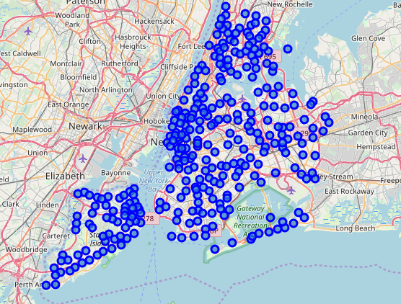
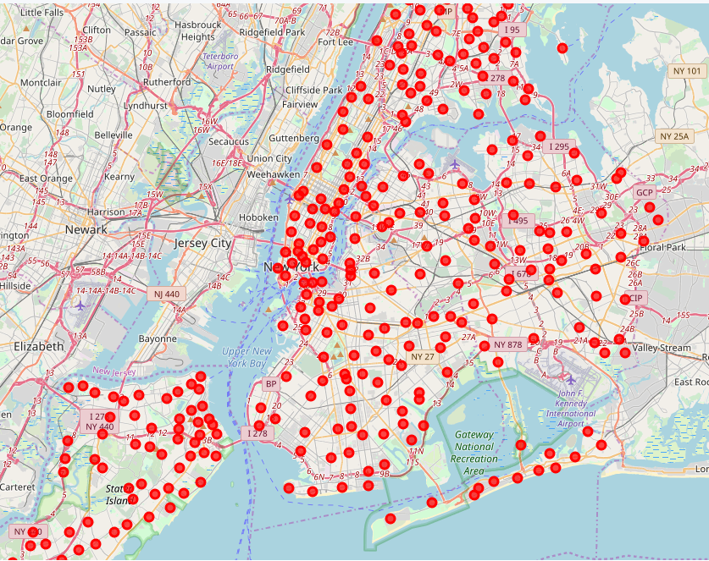
Results
Neighborhoods - New York
Cluster of Venues in 10 KMS

Slide 7
Recommendation/ Improvements:
In the Foursquare API, we have queried the Venues of a locality by specifying the LIMIT and Radius of our choice. We have chosen less LIMIT as the number of API calls that can be done using a free account in Four Square are less.
We can increase the limit for more accurate results.
We can adjust the Radius for more venue results from each city.
FourSquare trending venue data can also be further used to plan more accurately.

